Slide 1
UNIVERSITY OF BUEA
Faculty of Engineering and Technology
CEF440 - INTERNET PROGRAMMING AND MOBILE PROGRAMMING
TASK 3: REQUIREMENTS
ANALYSIS
GROUP 16
Course Instructor: Dr. Nkemeni Valery

Slide 2
INTRODUCTION
1
What is Requirements Analysis?
It is the process of figuring out exactly what customers or users need the system or software to do before building it.
What We Covered
I
Review & Analyse Requirements
II
Prioritize Requirements
III
Classify Requirements
IV
Software Requirements Specificaton
V
Validate with Stakeholders

Slide 3
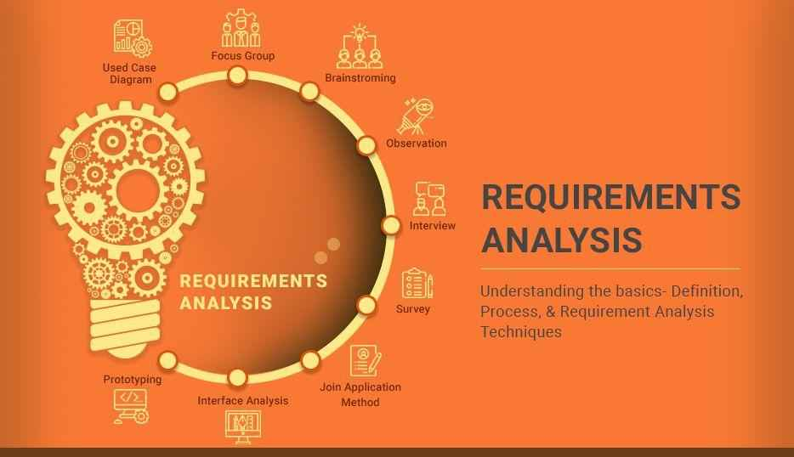
I
2
REVIEWING &
ANALYSING
REQUIREMENTS
GATHERED

Slide 4
Survey Overview & Respondent Demographics
3
190 participants across Buea, Yaounde, Douala, Bamenda, Limbe, Dschang, Kumba & Tiko.
Top Reported Network Issues
Slow Internet
89%
73.9%
72.9%
Signal Loss
34%
Age 18–25
Students
139 of 190 respondents
137 of 190 respondents
WhatsApp Fails
39%
Mobile Money
25%
75.9%
82.7%
MTN Users
4G / LTE
Dropped Calls
22%
145 of 191 respondents
Primary network gen.

Slide 5
Analysis: Completeness, Clarity & Feasibility
4
COMPLETENESS AREAS COVERED
CLEAR REQUIREMENTS
User Pain Points (89.1% cite slow internet)
Usage Patterns — 61.7% experience issues daily
App Adoption up to 87.8% conditional rate
Non-Functional Concerns — data, battery, privacy
Data Governance & Notification Preferences
Passive background monitoring
Personal speed history display
Geographic signal quality map
Operator comparison view
Configurable prompt frequency
Optional/approximate GPS with consent
TECHNICAL FEASIBILITY
Feasible
Challenging
Background monitoring · Speed history · Coverage map · Push notifications · Data upload
5G monitoring · Cross-operator comparison · Data anonymization at scale · iOS background limits

Slide 6
Inconsistencies, Ambiguities & Dependencies
5
KEY INCONSISTENCIES IDENTIFIED
Privacy vs. Location Mapping
47 said No to GPS, yet 86 want coverage map → design map with partial consent
No Prompts vs. Rewards
62 prefer silent monitoring yet 88 want rewards → passive reward model needed
Data Privacy vs. MNO Sharing
65 want data only for themselves vs. 82 support MNO access → per-user consent
Satisfaction Paradox
9 rated 5/5 yet reported daily issues → measure objective metrics, not just ratings
DEPENDENCY CHAIN
User Consent
OS Permissions
Background Monitoring
Local Storage
Data Upload
Coverage Map

Slide 7

6
II.
PRIORITIZED REQUIREMENTS

Slide 8
Priority Matrix: Importance × Feasibility
7
QUICK WINS
CRITICAL TO RETAIN
High Importance / High Feasibility
High Importance / Medium Feasibility
Personal Speed History (92 votes)
Low Data Consumption (127 concerns)
Network Coverage Maps (87 votes)
Low Battery Drain (69 concerns)
Passive Monitoring (62+ votes)
Network Operator Comparison
VALUE ADDS
DEFER
Moderate Importance / High Feasibility
Low Importance / Low Feasibility
Approximate Location Privacy (85 votes)
Frequent Manual Rating Prompts (35 votes)
Performance on Low-End Devices (45 concerns)
Exact Real-time GPS tracking

Slide 9
MoSCoW Prioritization
8
MUST-HAVE
COULD-HAVE
Minimal Data Consumption
Operator Comparison
Minimal Battery Impact
Automated Background Monitoring
Privacy & Approximate Location
Formal Complaint Support
Offline Storage & Sync
SHOULD-HAVE
WON'T-HAVE (Now)
Personal Speed History (92 votes)
Frequent Manual Rating Prompts
Signal Coverage Map (87 votes)
Real-time Exact GPS Tracking

Slide 10
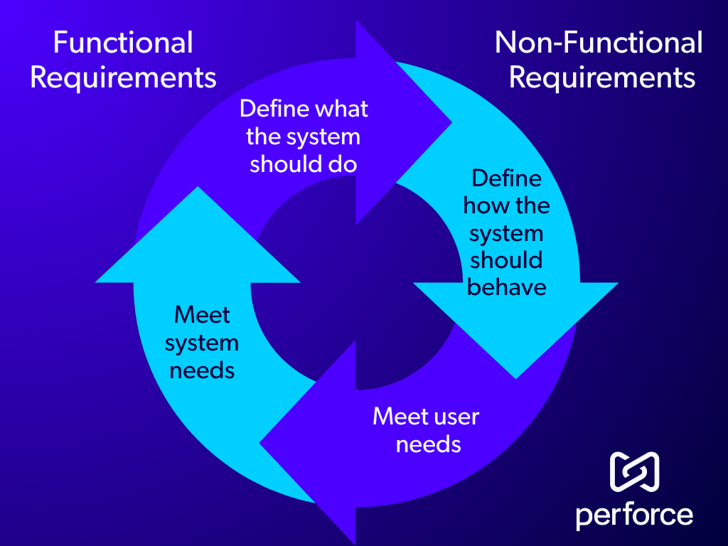
9
III.
REQUIREMENT
CLASSIFICATION

Slide 11
Functional Requirements
10
FR1
Background Network Monitoring
FR6
Network Coverage Map
Continuous collection without user interaction
Map of signal quality across locations
FR2
Network Metric Collection
FR7
Operator Comparison
Type, signal strength, speed, GPS, timestamp
Compare performance between operators
FR3
User Feedback Prompts
FR8
Anonymous Data Sharing
Periodic prompts to rate network experience
Share anonymized data with MNOs
FR4
Fully Automatic Mode
FR9
Offline Data Storage
Silent collection with no user prompts
Store locally and sync when online
FR5
Internet Speed History
FR10
Network Problem Alerts
Store & display personal speed log over time
Notify user of significant quality drops

Slide 12
Non-Functional Requirements
11
Performance
Privacy & Security
Compatibility
Battery ≤ 5% per hour during background ops
GPS coordinates anonymized before storage/transmission
Android 8.0+ incl. Tecno, Itel, Infinix
Mobile data < 10 MB/day for background ops
All transmitted data encrypted end-to-end
No noticeable slowdown on entry-level devices
Clear transparency disclosure on first run
Usability
Reliability
First-time users navigate without training
Background service auto-restarts if killed by OS
Bilingual support: English & French
Offline data buffered and synced on reconnect

Slide 13

12
IV.
SOFTWARE REQUIREMENTS SPECIFICATION
(SRS)

Slide 14
Software Requirements Specification (SRS)
13
Purpose
USER CLASSES
Defines complete functional & non-functional requirements for the Mobile Network QoE Monitoring App — primary reference for dev team & supervisors.
Mobile Subscriber
Non-technical
Everyday Cameroonian phone users 18+
Scope
Network Operator Analyst
High
MTN, Orange, Camtel — accesses backend data
Native Android app running continuously in the background on subscriber devices, collecting objective metrics + subjective ratings, then syncing to a remote server.
Developer / Administrator
High
Builds, deploys and maintains the system
Operating Environment
Android 8.0+, entry-level devices (Tecno, Itel, Infinix) to high-end, across 2G/3G/4G/LTE networks. Online and offline conditions. Urban, peri-urban & rural Cameroon.
KEY CONSTRAINTS
Native Android only
Min 2GB RAM · HTTPS/TLS 1.2+ encryption · No PII collected
Explicit user consent before any data collection

Slide 15
SRS: Use Cases, Data & Validation
14
USE CASES
KEY DATA FIELDS
UC-01
Install & Onboard
Field
Unit
Description
Privacy notice → permissions → language → mode selection → dashboard
reading_id
UUID
Unique record identifier
signal_strength
dBm
RSSI at time of reading
UC-02
Background Monitoring
latency
ms
Round-trip ping delay
Every 5 min: collect metrics, GPS tag, timestamp, store locally, queue sync
qoe_score
0–10
Weighted QoE calculation
user_rating
1–5
Subjective satisfaction
UC-03
Respond to Feedback Prompt
latitude / longitude
±500m
Anonymised approximate GPS
is_drop_event
Boolean
Triggered by network drop
Notification → rate 1–5 → optional note → log rating + metrics together
synced_to_server
Boolean
Server sync status flag
UC-04
View Dashboard & History
Current status → 7/30-day graph → coverage map with colour-coded signal

Slide 16

15
V.
REQUIREMENTS
VALIDATION
WITH STAKEHOLDERS

Slide 17
Validation Process & Addressing Gaps
16
Primary validation source: 190 Mobile Network Subscriber survey responses (ISP technical feedback pending)
1
Prioritizing User Needs
Compared feature list against reported pain points (unstable connections, high data costs). Validated need for background objective metric collection (latency, packet loss).
2
Verifying Feature Usefulness
Users confirmed simple rating system (satisfaction, response time, usability) with timestamps is a feature they would engage with.
3
Dependency Risk
Added requirement for fully autonomous logging — app doesn't rely on ISP-side data, mitigating missing ISP feedback risk.
4
User Cost Concerns
Survey showed hesitancy about data consumption. Added "Data-Only-on-Wi-Fi" sync option to SRS.

Slide 18
CONCLUSION & WHAT'S NEXT
17
PHASE SUMMARY
✔
Requirements Gathered & Validated
✔
Conflicts & Gaps Resolved
190-respondent survey confirmed pain points, feature priorities, and non-functional constraints with traceable evidence.
4 key inconsistencies identified (GPS privacy vs. map, prompts vs. rewards) and resolved with design decisions baked into the SRS.
✔
Requirements Fully Classified
✔
Priorities Established
32 requirements documented in SRS v1.0: 10 FRs covering monitoring, feedback, alerts, storage & privacy; 20 NFRs across performance, security, and reliability.
MoSCoW method applied — Must-Haves define the MVP; Should/Could-Haves scope future iterations. Feasibility matrix guides development effort.
WHAT'S NEXT
Task 4
System Modeling and Design
Translating the SRS into architecture diagrams, database schema, UI wireframes, and API contracts.

